Slide 1

Project Apollo
An open source oxygen concentrator
http://project-apollo.org
Microsoft Volunteers
Carsten Avenhaus, Stephen Carlson, Adi Oltean,
Saqib Shaik, Shivkumar Swaminathan HelpfulEngineering.org non-profit (19K volunteers!)
Devon Rowland Quick2space.org non-profit
Adi Oltean

Slide 2

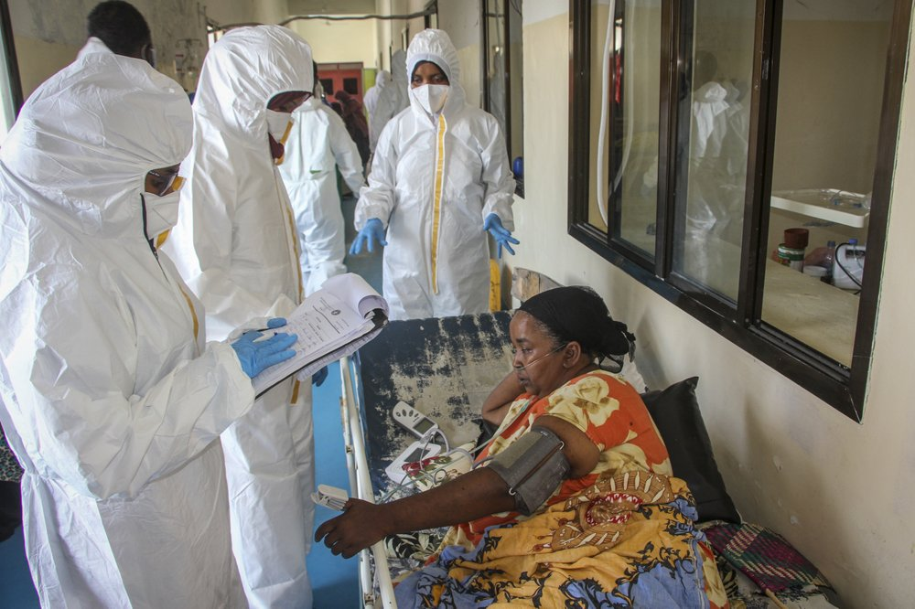
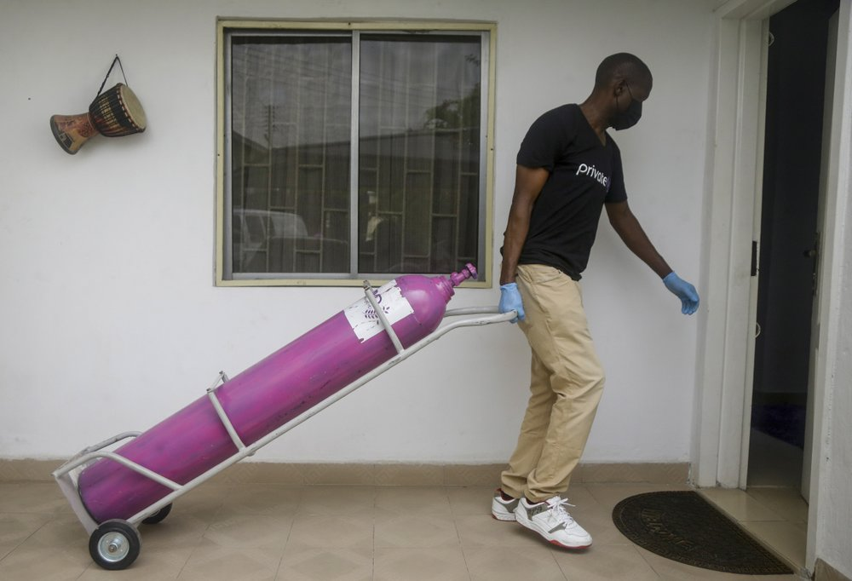
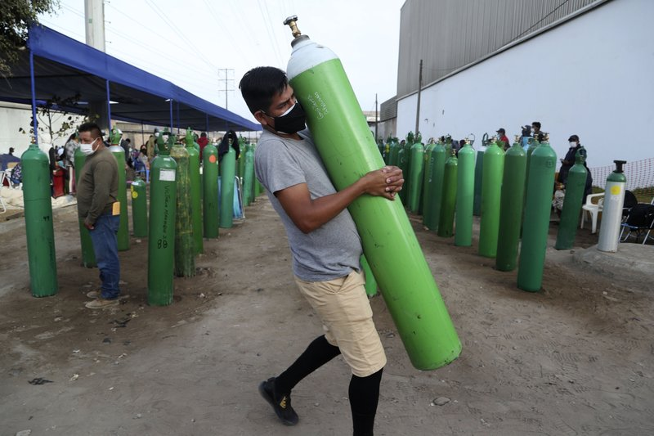

Project Apollo
Why
O2 needed for ventilators, oxygen therapy
Typical FiO2 0.3 … 0.5, up to 1
Oxygen generation is a big problem in developing countries
No established infrastructure
Oxygen bottles are expensive
People are already looking at alternative (local) ways for producing and delivering oxygen
https://www.economist.com/graphic-detail/2021/03/09/hospitals-are-running-out-of-oxygen-to-treat-covid-19-patients
https://www.cidrap.umn.edu/news-perspective/2021/03/who-sounds-alarm-over-covid-linked-oxygen-crisis
https://apnews.com/article/oxygen-crisis-africa-latin-america-eb0d2731a8613c1ae218db7d32a227a6

Slide 3

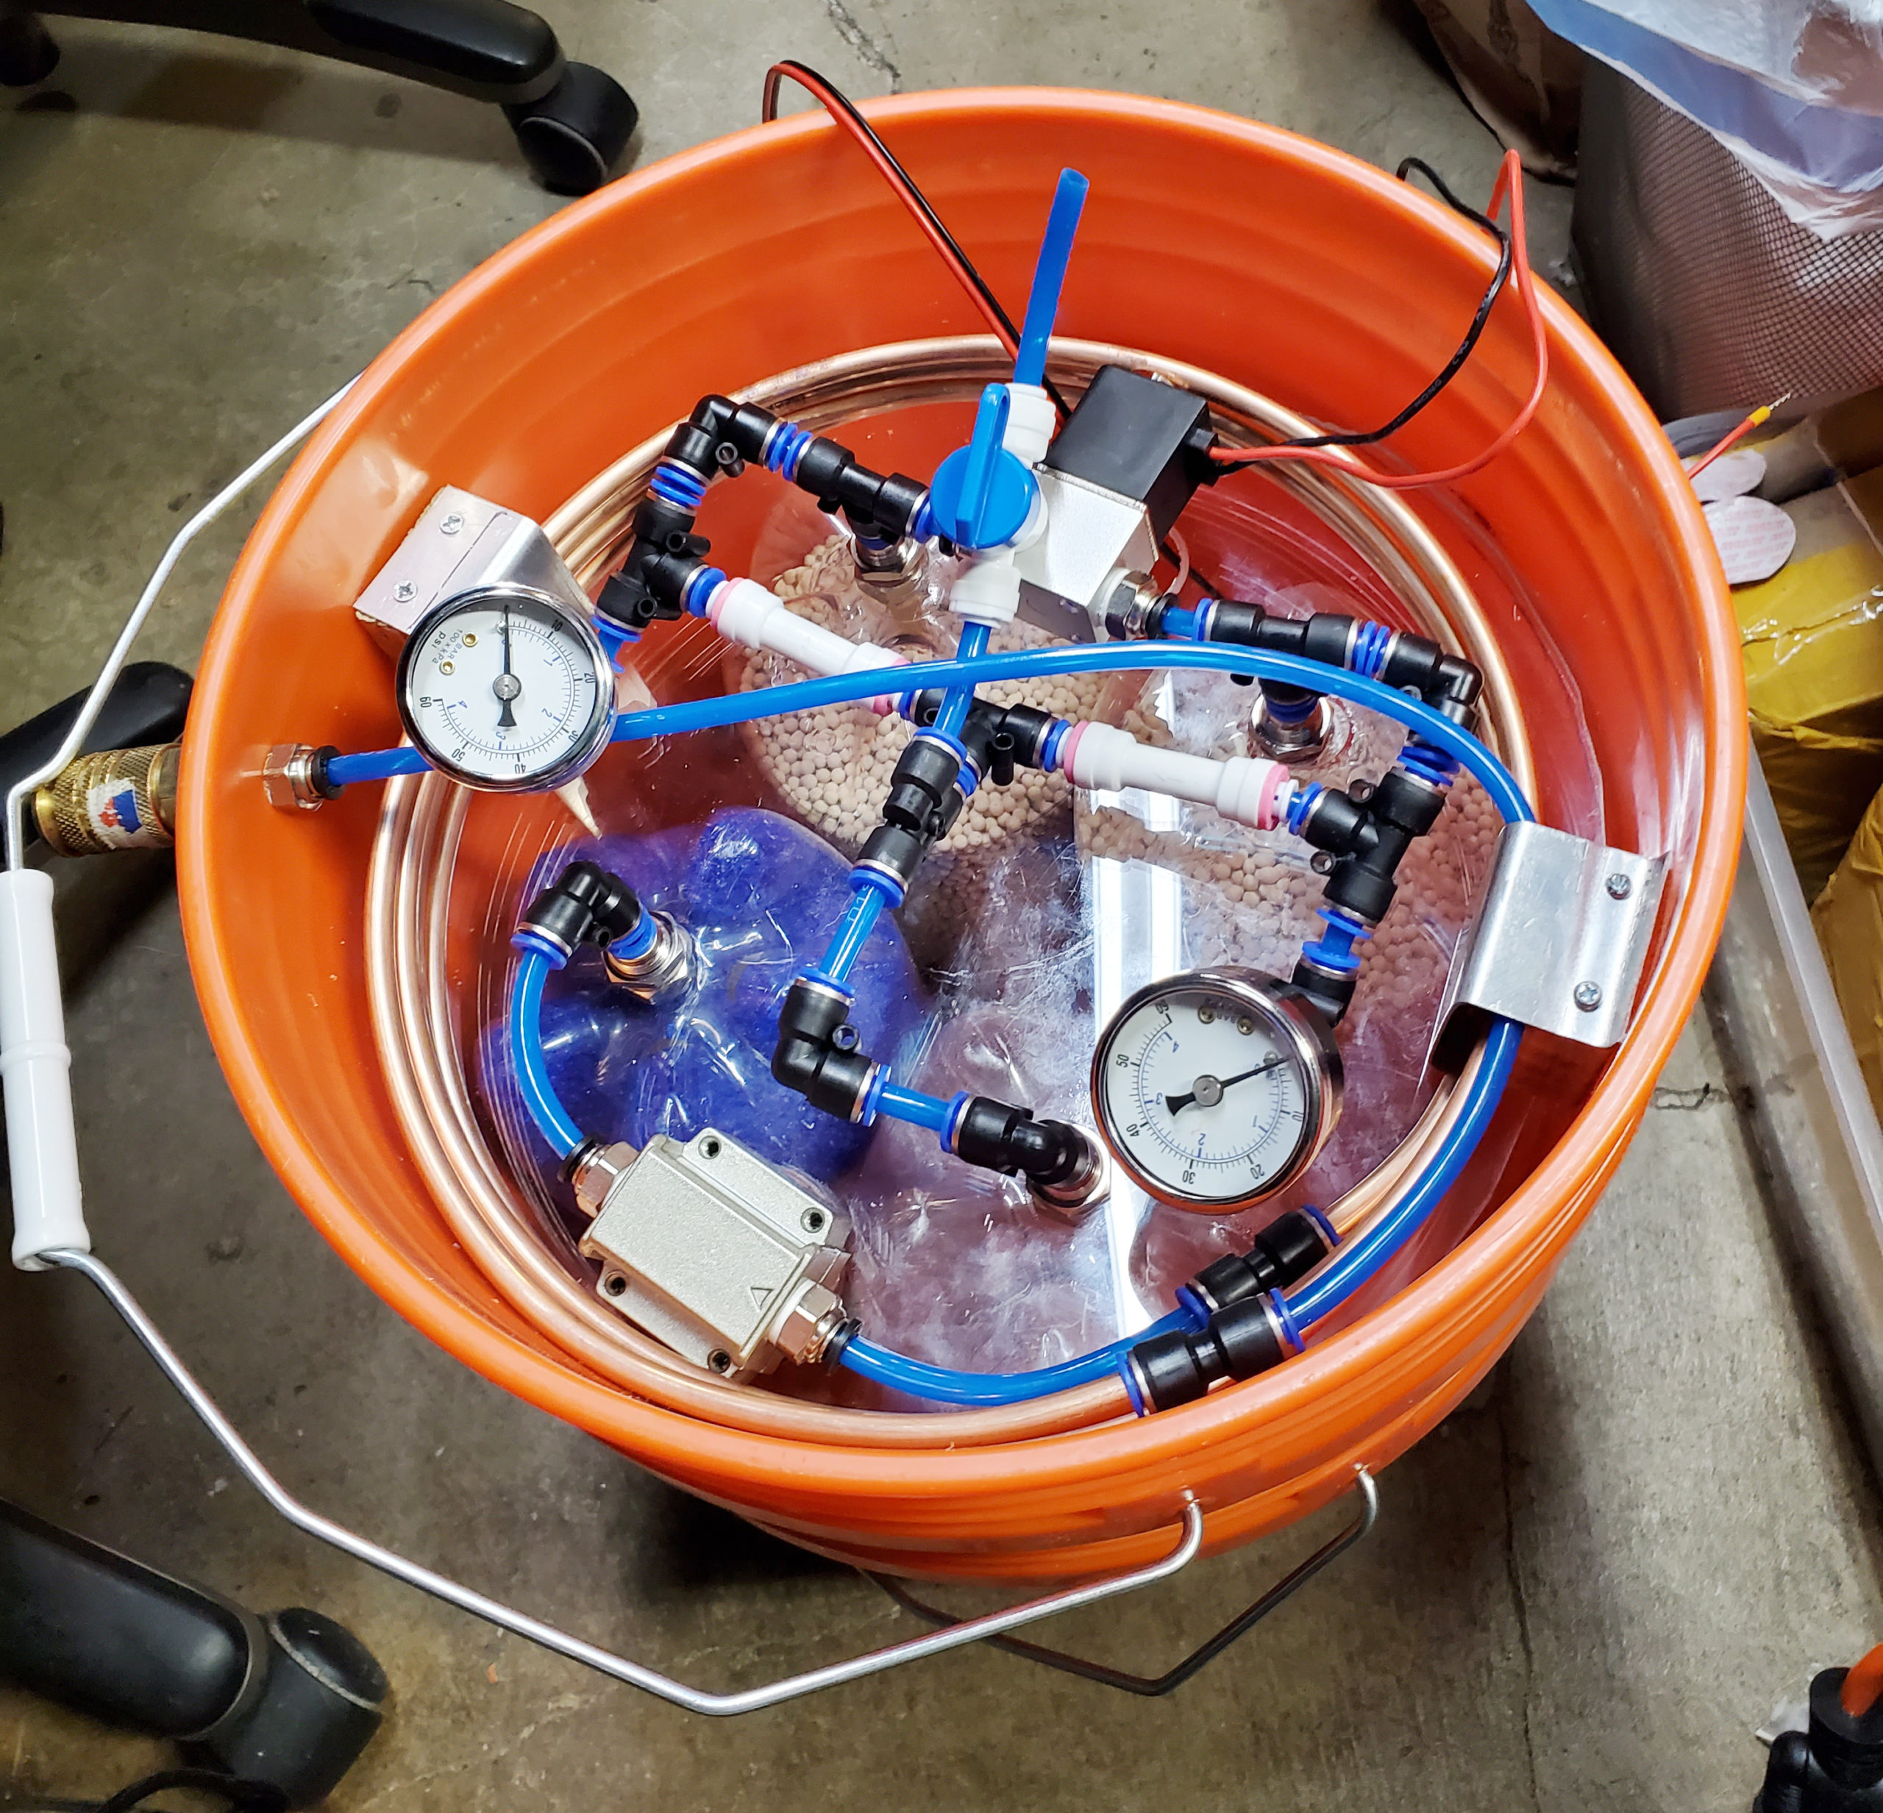
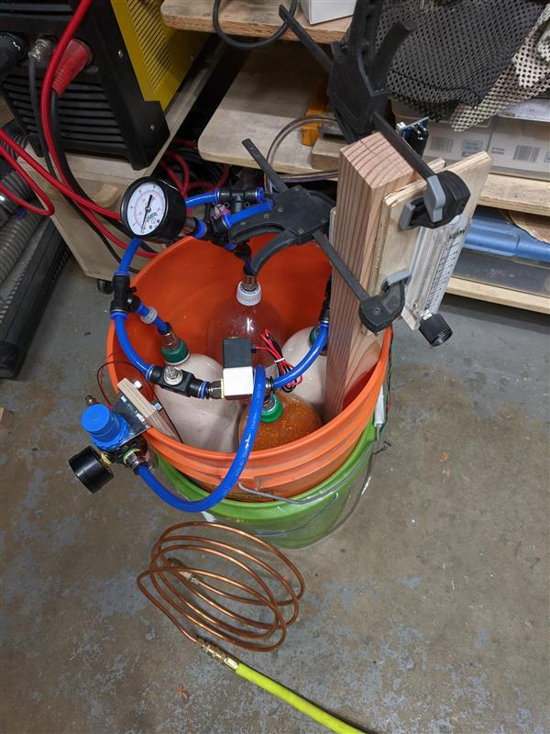
Project Apollo
What is it
Goal = enabling people around the world to build the prototype ASAP
Focus = Simplicity and speed of build
Simple, reliable design (zeolite-based PSA system)
Flexible, open source, off-the-shelf materials
Very low cost (aspirational target = $200 for 15 liters/min @ 80%)
Final goal = Enable people to iterate and publish their own designs in the community

Slide 4

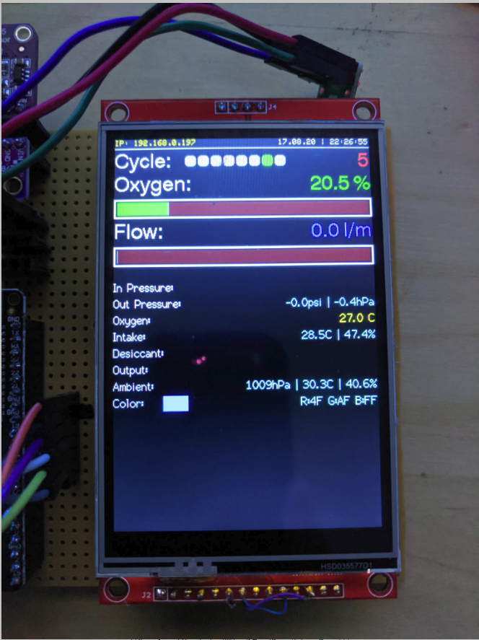
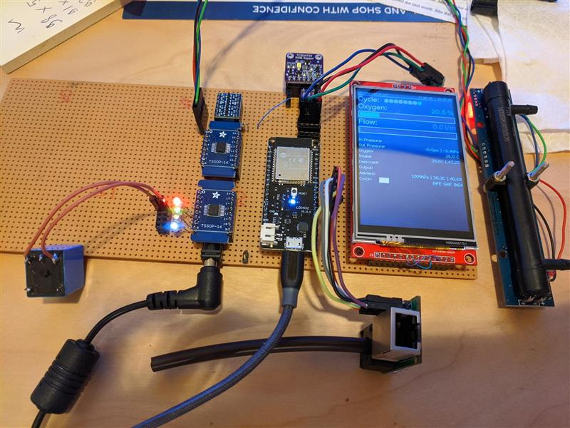
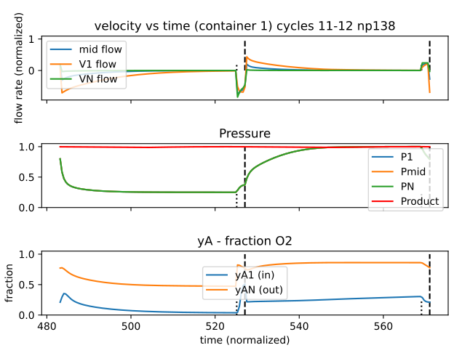
Project Apollo v4
Apollo v4
Focus = medical device
Safety: detect all failure scenarios
Ease of use: User experience and maintainability. Clear, actionable error messages
Self-regulating: Patient sensor/data feedback loop
Control box
Touch screen for diagnostic messages, medical-grade buzzer
Open source, modular PCB design. Works with a variety of sensors
Self-tuning: valve timing, auto-adjusts to changes in compressed air input pressure, machine learning
Integration with SpO2 oximeter Bluetooth sensor
Cloud data integration for patient monitoring
Self-contained enclosure
Built-in compressor
Full focus on thermals, airflow, noise reduction
Collaborations
Funding: Quick2space.org
Volunteers: Helpful Engineering, Microsoft Garage, Public Invention
Documentation, code
http://project-apollo.org

Slide 5
Apollo - Hack4Good Spring 2021
What we have achieved in this hackathon
PCB schematic/layout for the valve board
What is it: central PCB to drive all valves and detect failures
What we did: finalized Friday late night!
Prototyped integration of SpO2 oximeter sensor into Apollo code
What is it: Allows reading of SpO2 oxygen concentration in blood
Used this as a closed feedback loop to drive oxygen output
Important to not deliver too much oxygen!
What we did: prototyped and integrated Bluetooth LE code
Project Bonsai ML simulator code
What is it: Uses Reinforcement Learning to self-optimize the concentrator
What we did: Repro previous results in a separate Azure Bonsai instance, Document simulation code
Apollo v4 software
What is it: the “brain” behind the oxygen concentrator
What we did: Code cleanup, adding comments
http://project-apollo.org

Slide 6
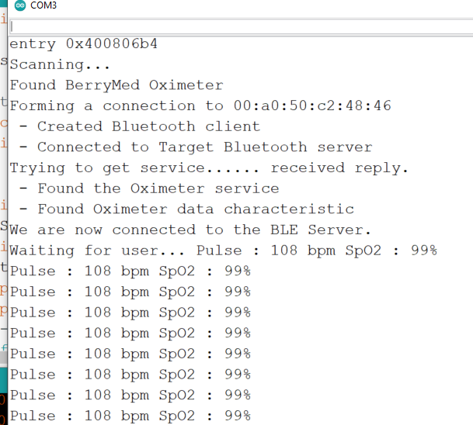
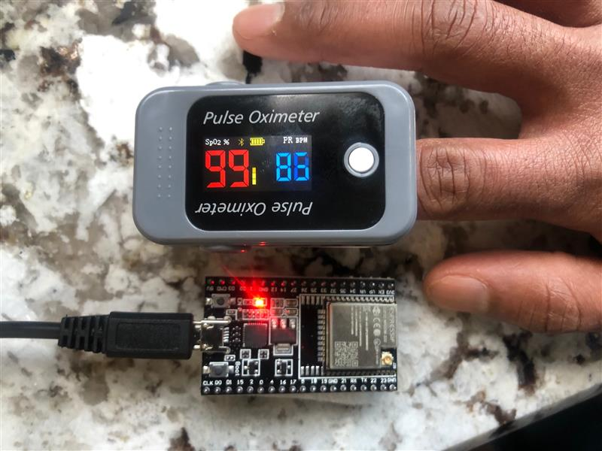
Apollo v4: Bluetooth SpO2 sensor
http://project-apollo.org

Slide 7
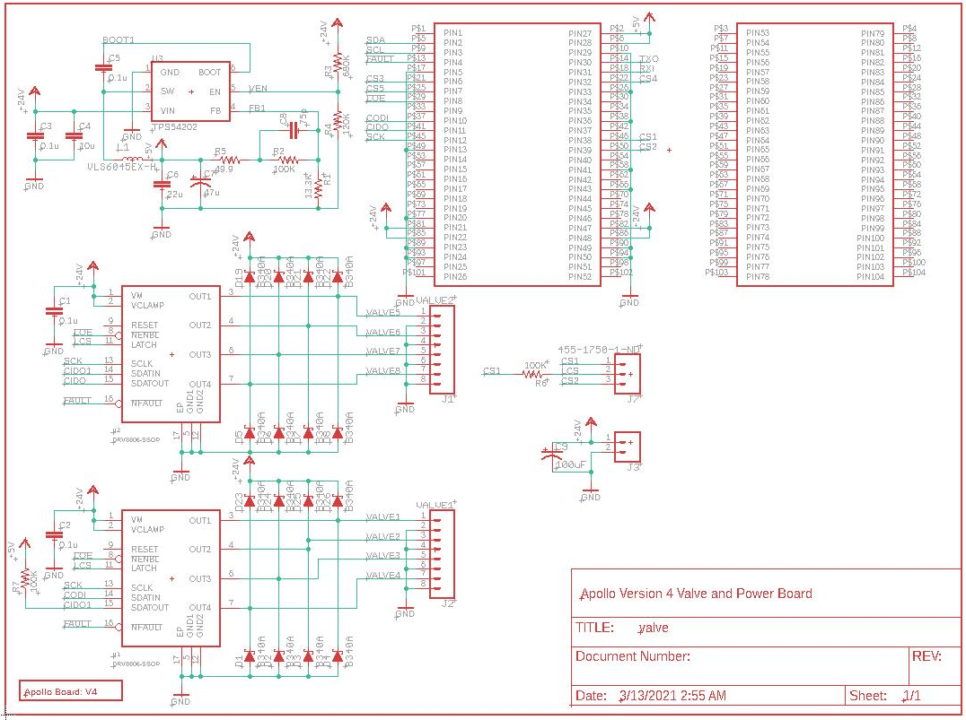
Apollo v4: valve board schematic
http://project-apollo.org

Slide 8
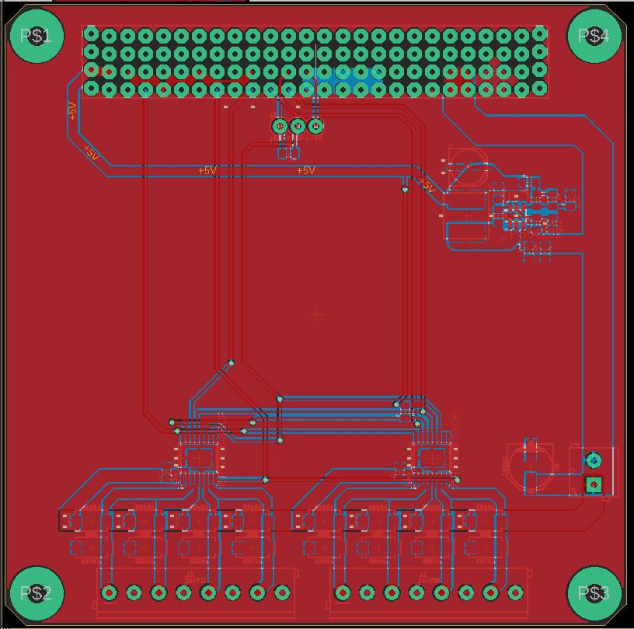
Apollo v4: valve board layout
http://project-apollo.org

Slide 9
Conclusion
Key items developed/prototyped
Valve board, SpO2 sensor, Apollo software, Apollo ML simulator stack
Next steps
Finalize Apollo v4 in the next 3-6 months
FDA emergency use approval
Thanks
Microsoft Hack4good community
for helping create the context for amazing work
Helpful Engineering.org non-profit
Community of 19,000 engineers going strong
Help from QA/RA volunteers from the medical industry helping with regulatory compliance
Help with FDA certification of the upcoming device
Quick2space.org
support/funding for materials
http://project-apollo.org

Slide 10
Thank you!
http://project-apollo.org

Slide 11
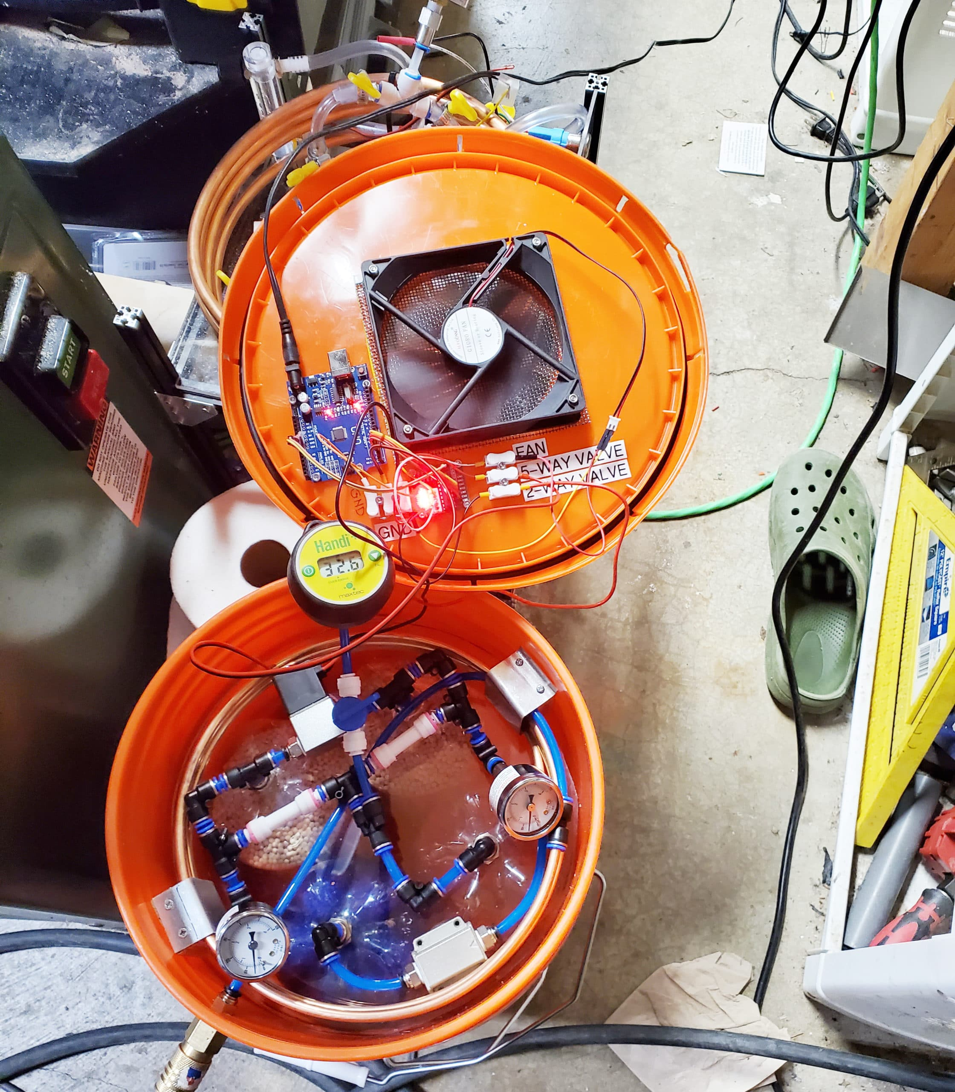
Project Apollo v2 (previous work)
Published one year ago
Oxygen concentrator prototype using household materials
Build instructions - documentation
$260 material cost – BOM
Multiple iterations/variants have been built
O2 concentration 45 … 70%, 5 lpm

Slide 12
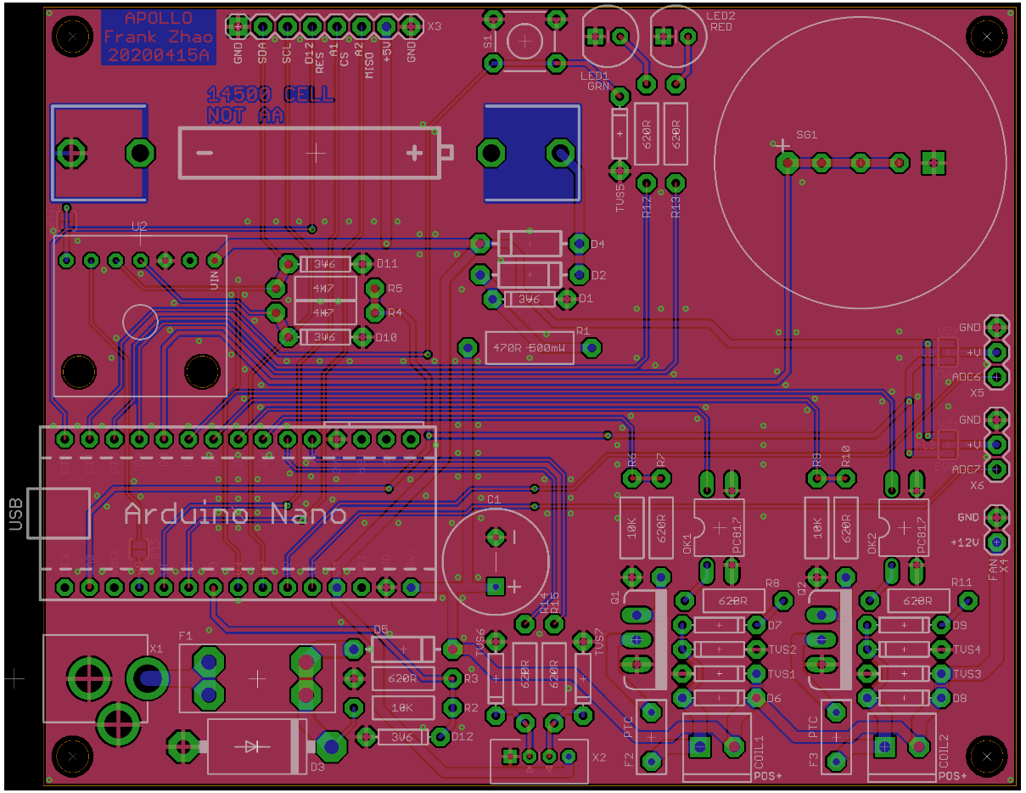
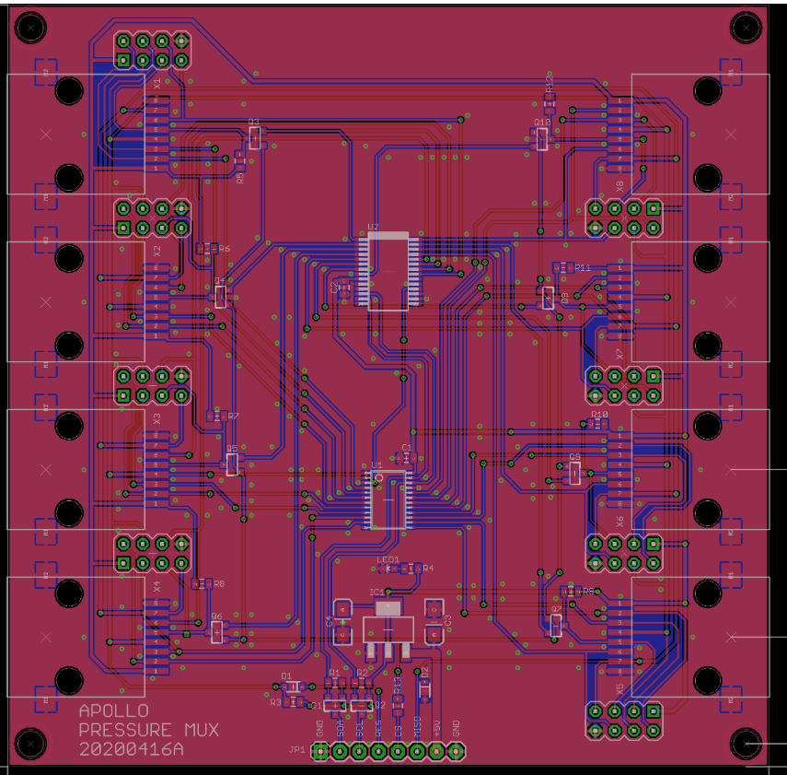
Apollo v4 (previous work)
http://project-apollo.org

